Slide 1
Chip
Primary
Shear Zone
Rake MWF
Application
Rake
Workpiece
Flank
Tool
Flank MWF
Application

Slide 2

Workpiece
Chip
Tool
Lx=1.27mm
1.27mm
Workpiece
Velocity
5°
0.31mm
Ly=4.76mm
4.78mm
y
h
x
o
0.416mm
z
Nozzle

Slide 3
5°
Boundary
Velocity
Penetration Distance
Tool
Workpiece
y
z
Lubricant Initial Velocity
o
x

Slide 4
Workpiece
Tool
y
x
o
z
(a)
(b)

Slide 5
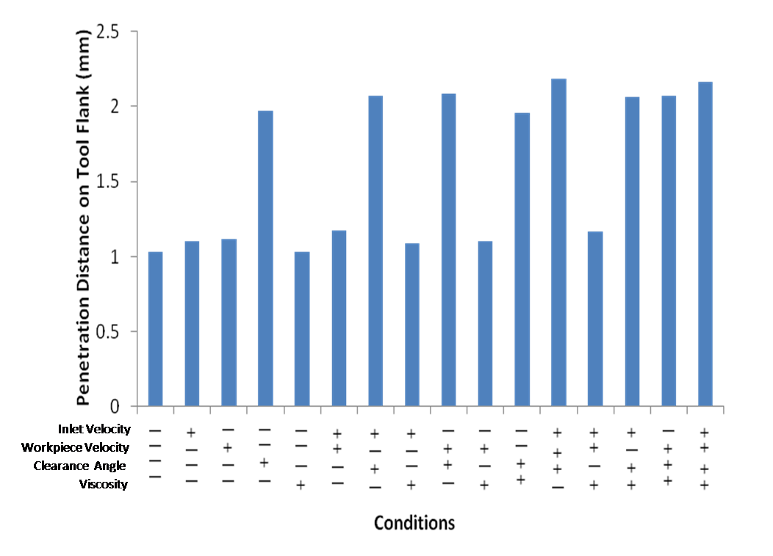

Slide 6
96.24%
100%
100%
30.45%
21.52%
Emulsion Flood
Lubricant Spray
Emulsion Spray
ScCO₂ Spray
N₂ Spray

